Slide 1
Customer Segmentation for an Online Store using K-Means Clustering
PRESENTED BY
MD LIMON MIA ANANNA RANI DASH
Roll:08 Roll:09
DEPARTMENT OF CSE
DHAKA INTERNATIONAL UNIVERSITY
08/08/25

Slide 2
Introduction:
Growth of e-commerce → more customer data
Importance of understanding customer behavior
Goal: Use ML to segment customers for better marketing

Slide 3
Problem Statement:
Businesses struggle to market effectively to a diverse customer base
Need to group similar customers Customer Segmentation
Traditional methods are limited Use K-Means Clustering

Slide 4
Objectives:
Segment customers based on income and spending
Identify patterns to support targeted marketing
Improve business decision-making using data insights

Slide 5
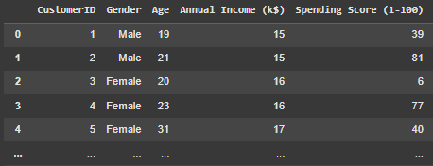
Dataset Overview:
Source: Kaggle (E-Commerce Customer Data)
Key Features:
Gender
Age
Annual Income (k$)
Spending Score (1–100)

Slide 6
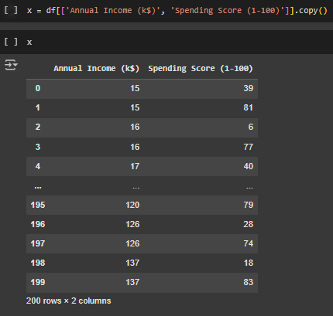
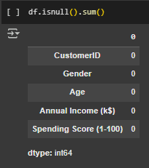
Data Preprocessing:
Checked for missing values (none)
Selected features: Annual Income and Spending Score
Applied StandardScaler for normalization

Slide 7
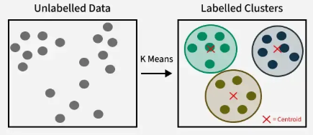

K-Means Clustering Algorithm:
Choose number of clusters K
Randomly initialize K centroids
Assign each data point to the nearest centroid
Recompute centroids as the mean of assigned points
Repeat steps 3–4 until centroids don’t change (converge)

Slide 8
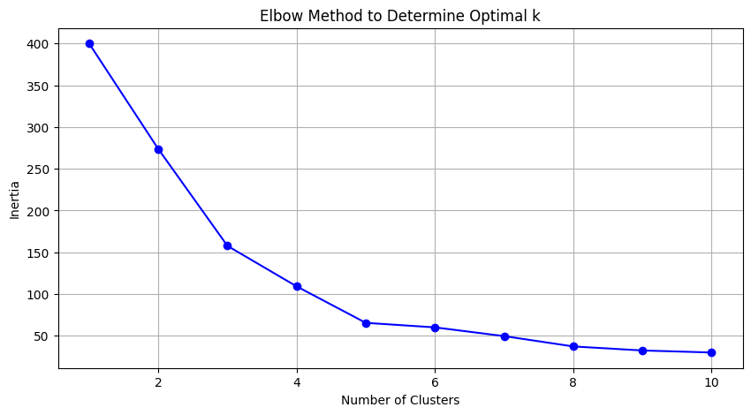
Choosing Optimal Clusters:
Used Elbow Method
Plotted Inertia vs. Number of Clusters
Optimal k = 5 (based on elbow curve)

Slide 9
Cluster Visualization:
2D scatter plot using Matplotlib
X-axis: Income (scaled)
Y-axis: Spending Score (scaled)
5 Color-coded Clusters

Slide 10
Cluster Interpretation:
High Income, Low Spending
Low Income, Low Spending
High Income, High Spending (Target)
Moderate Income, High Spending (Loyal)
Low Income, High Spending (Irregular)

Slide 11
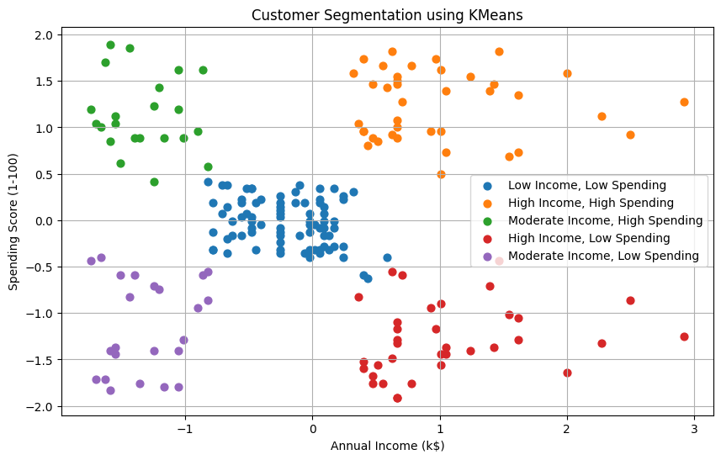

Slide 12
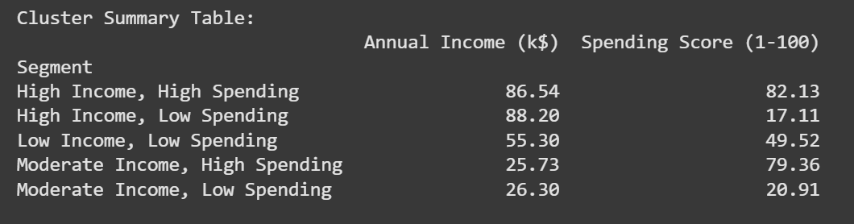

Slide 13
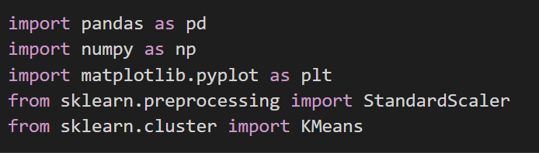
Tools & Libraries Used:
Python
Scikit-learn → Clustering, scaling
Matplotlib → Visualization
Pandas → Data handling
Google Colab

Slide 14
Conclusion:
K-Means helped uncover meaningful customer segments
Business can now tailor marketing efforts more effectively
Achieved the goal of improved customer understanding

Slide 15
References:
Jain, A. K. (2010). Data clustering: 50 years beyond K-means. *Pattern Recognition Letters.
Vijay Choudhary, “Customer Segmentation Dataset,” Kaggle. [Online]. Available:https://www.kaggle.com/datasets/vjchoudhary7/customer-segmentation-tutorial-in-python
[3] Kotler, P., and Keller, K.L., “Marketing Management,” 15th ed., Pearson Education, 2016.
https://www.analyticsvidhya.com/blog/2019/08/comprehensive-guide-k-means-clustering/

Slide 16
Q&A
Open for questions
Thank You!

